Slide 1
EDA & Business Intelligence
SQL | Data Analyst Project |J Giridhar

Slide 2
Project Objective
Perform EDA
Answer business questions using SQL
Build KPI dashboard

Slide 3
Dataset Overview
Orders | Sales | Profit | Category | Region

Slide 4
Key KPIs
Total Sales
Total Profit
Profit Ratio
Top Products
Monthly Growth

Slide 5
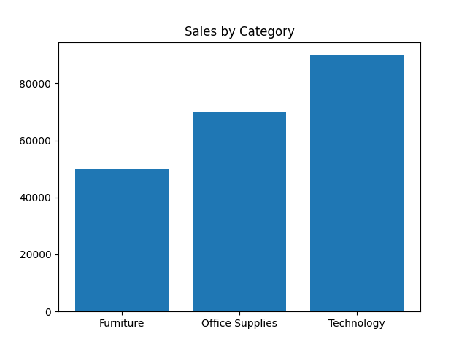
Sales by Category

Slide 6
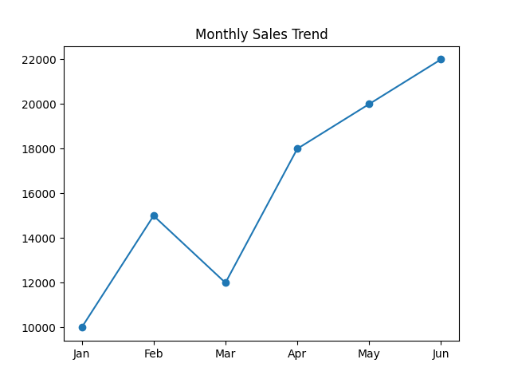
Monthly Sales Trend

Slide 7
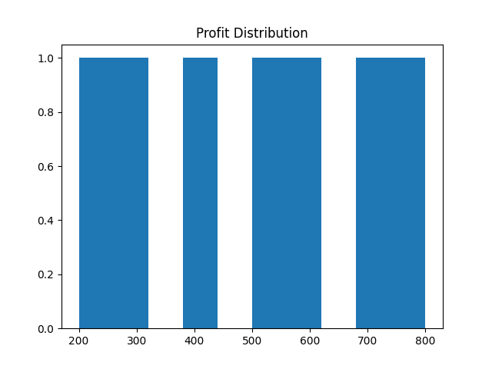
Profit Distribution

Slide 8
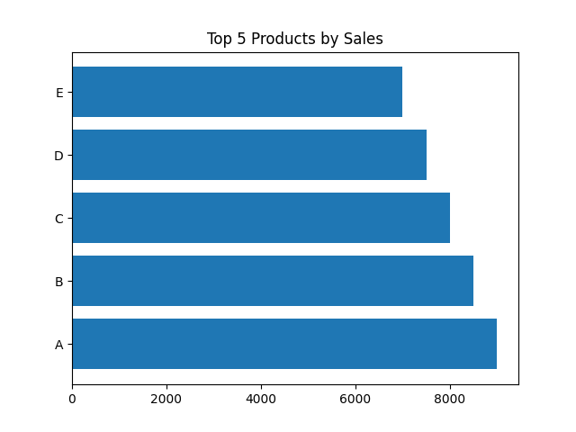
Top Products

Slide 9
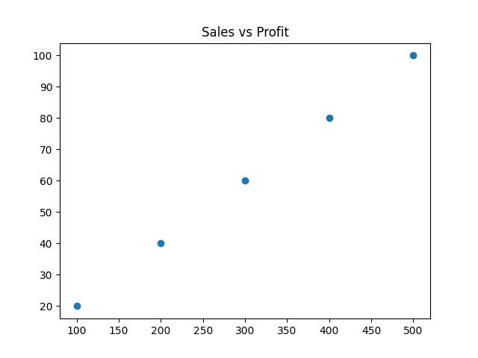
Sales vs Profit

Slide 10
Key Insights
Technology drives highest revenue
Sales show steady monthly growth
Strong positive Sales–Profit relationship

Slide 11
Conclusion
EDA converts raw data into business decisions
SQL enables data extraction
Dashboard supports quick monitoring

